Slide 1


2024 HCA Single-Cell Omics in-person Computational and Experimental Design Workshop Group Projects
June 24-28, 2024
Bangkok, Thailand

Slide 2
Aims for Wet-lab track
Go through the manuscripts if you have questions ask your training leaders
Explain the methodology used and the experimental design
Why were these selected
How many samples? What technology? What was the sample preparation (Ie dissociation, sorting, enrichment)
What would you change or improve

Slide 3
Aims for Computational track
You will get a subset dataset from the paper and some prompts to guide your analysis
BUT feel free to try new things and explore the data
Discuss with the wetlab team on the goals of the paper and how to interpret the data

Slide 4
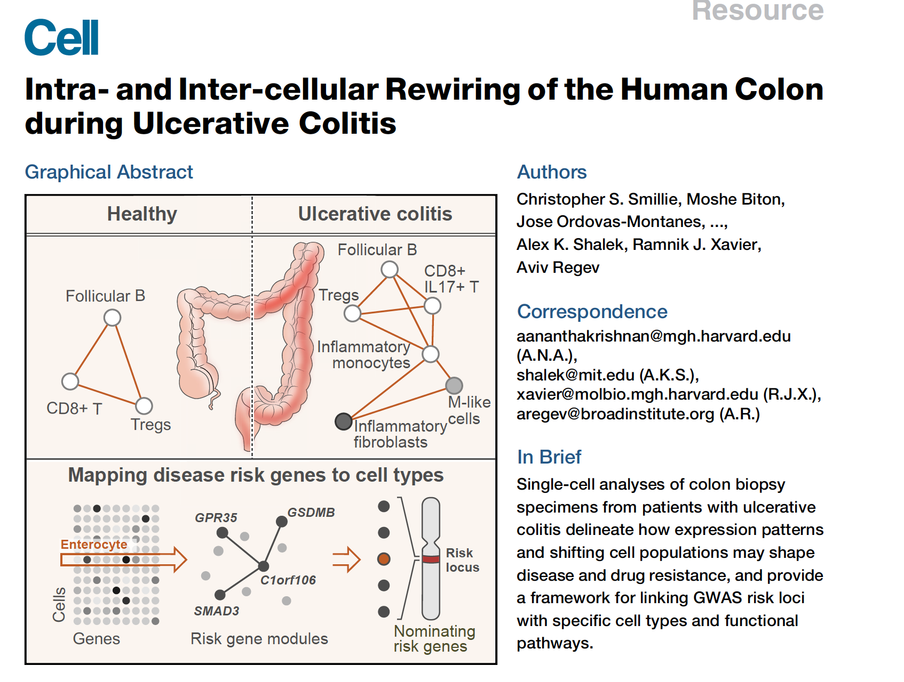
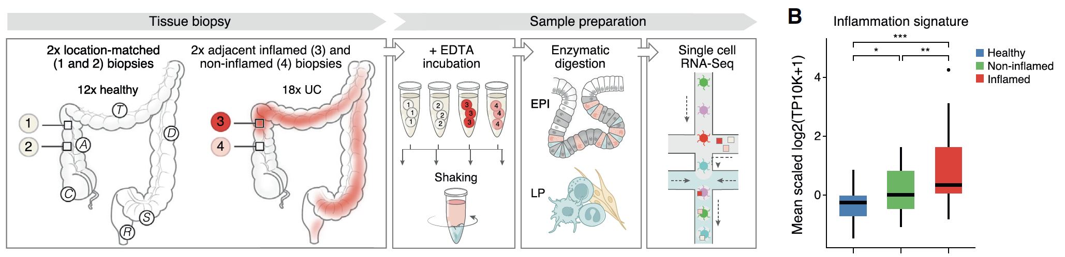
Project 1.

Slide 5
Project 1.
Single-cell analyses of colon biopsy specimens from patients with ulcerative colitis delineate how expression patterns and shifting cell populations may shape disease
What do you get:
4500 cells
30 Donors
3 Types of samples (Healthy and Ulcerative colitis (Non-inflamed and Inflamed))
Questions to Answer.
What is the quality of the cell? Do you need to filter cells?
Is there any batch effect?
What are the main cell types present in the sample?
Do you see any differential expression between the 3 types of samples?

Slide 6

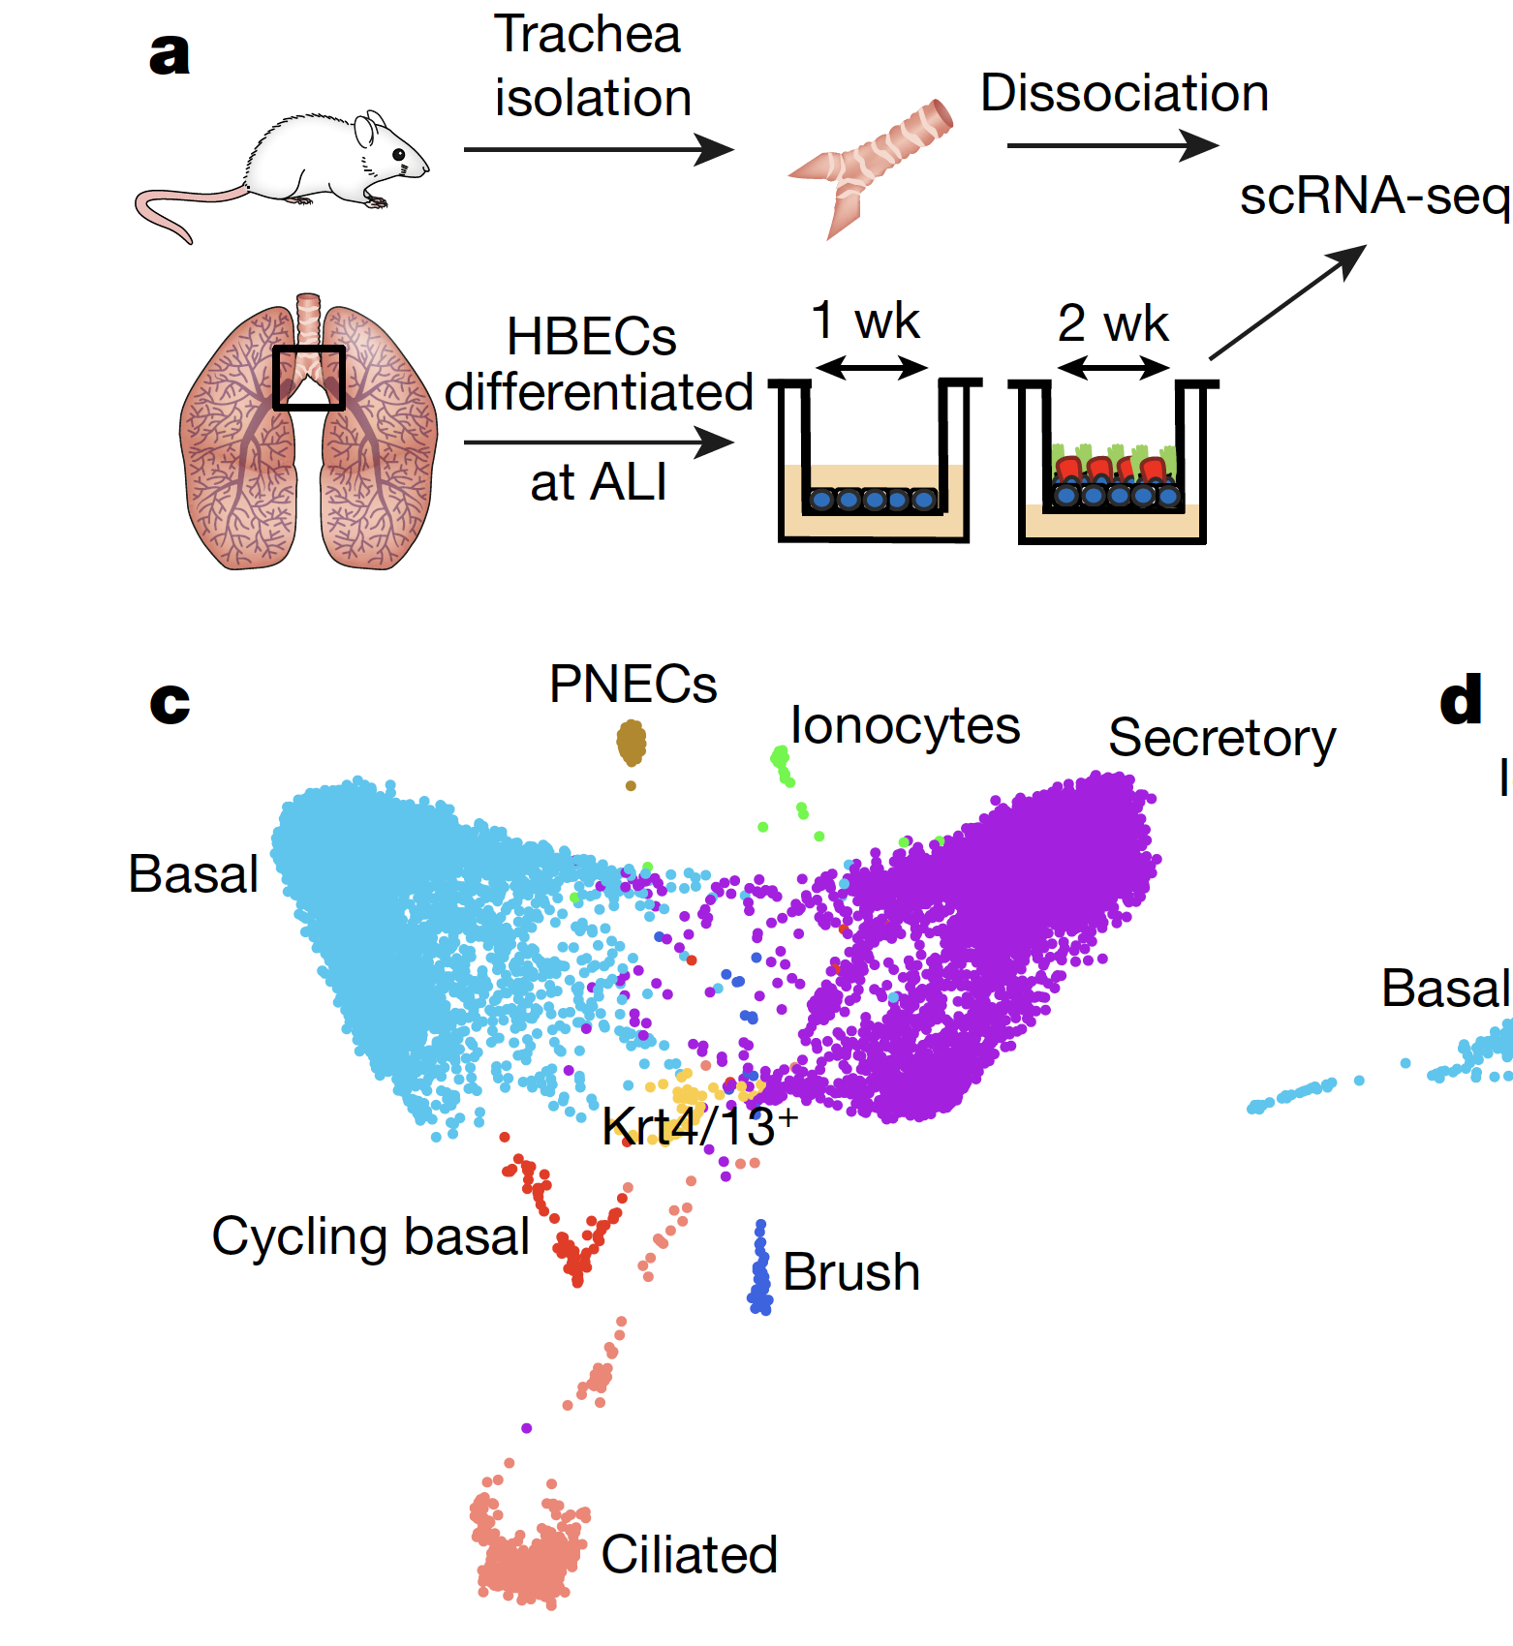
Project 2

Slide 7
Project 2.
Single-cell analyses reveals cell states that represent known and novel cell populations of the lung, They identified a novel, rare cell type that they call the ‘pulmonary ionocyte’, which co-expresses FOXI1, H+-ATPase (V-ATPase) and CFTR, the gene that is mutated in cystic fibrosis.
What do you get:
From Human
2970 cells
3 Donors
From Mouse
2912 cells
10 Mouse
5 Time points!
Questions to Answer.
What is the quality of the cell? Do you need to filter cells?
Is there any batch effect?
What are the main cell types present in the sample? Can you detect “Pulmonary Ionocyte”? Any changes across time?
Do you see any differences between Mouse and Human data?

Slide 8
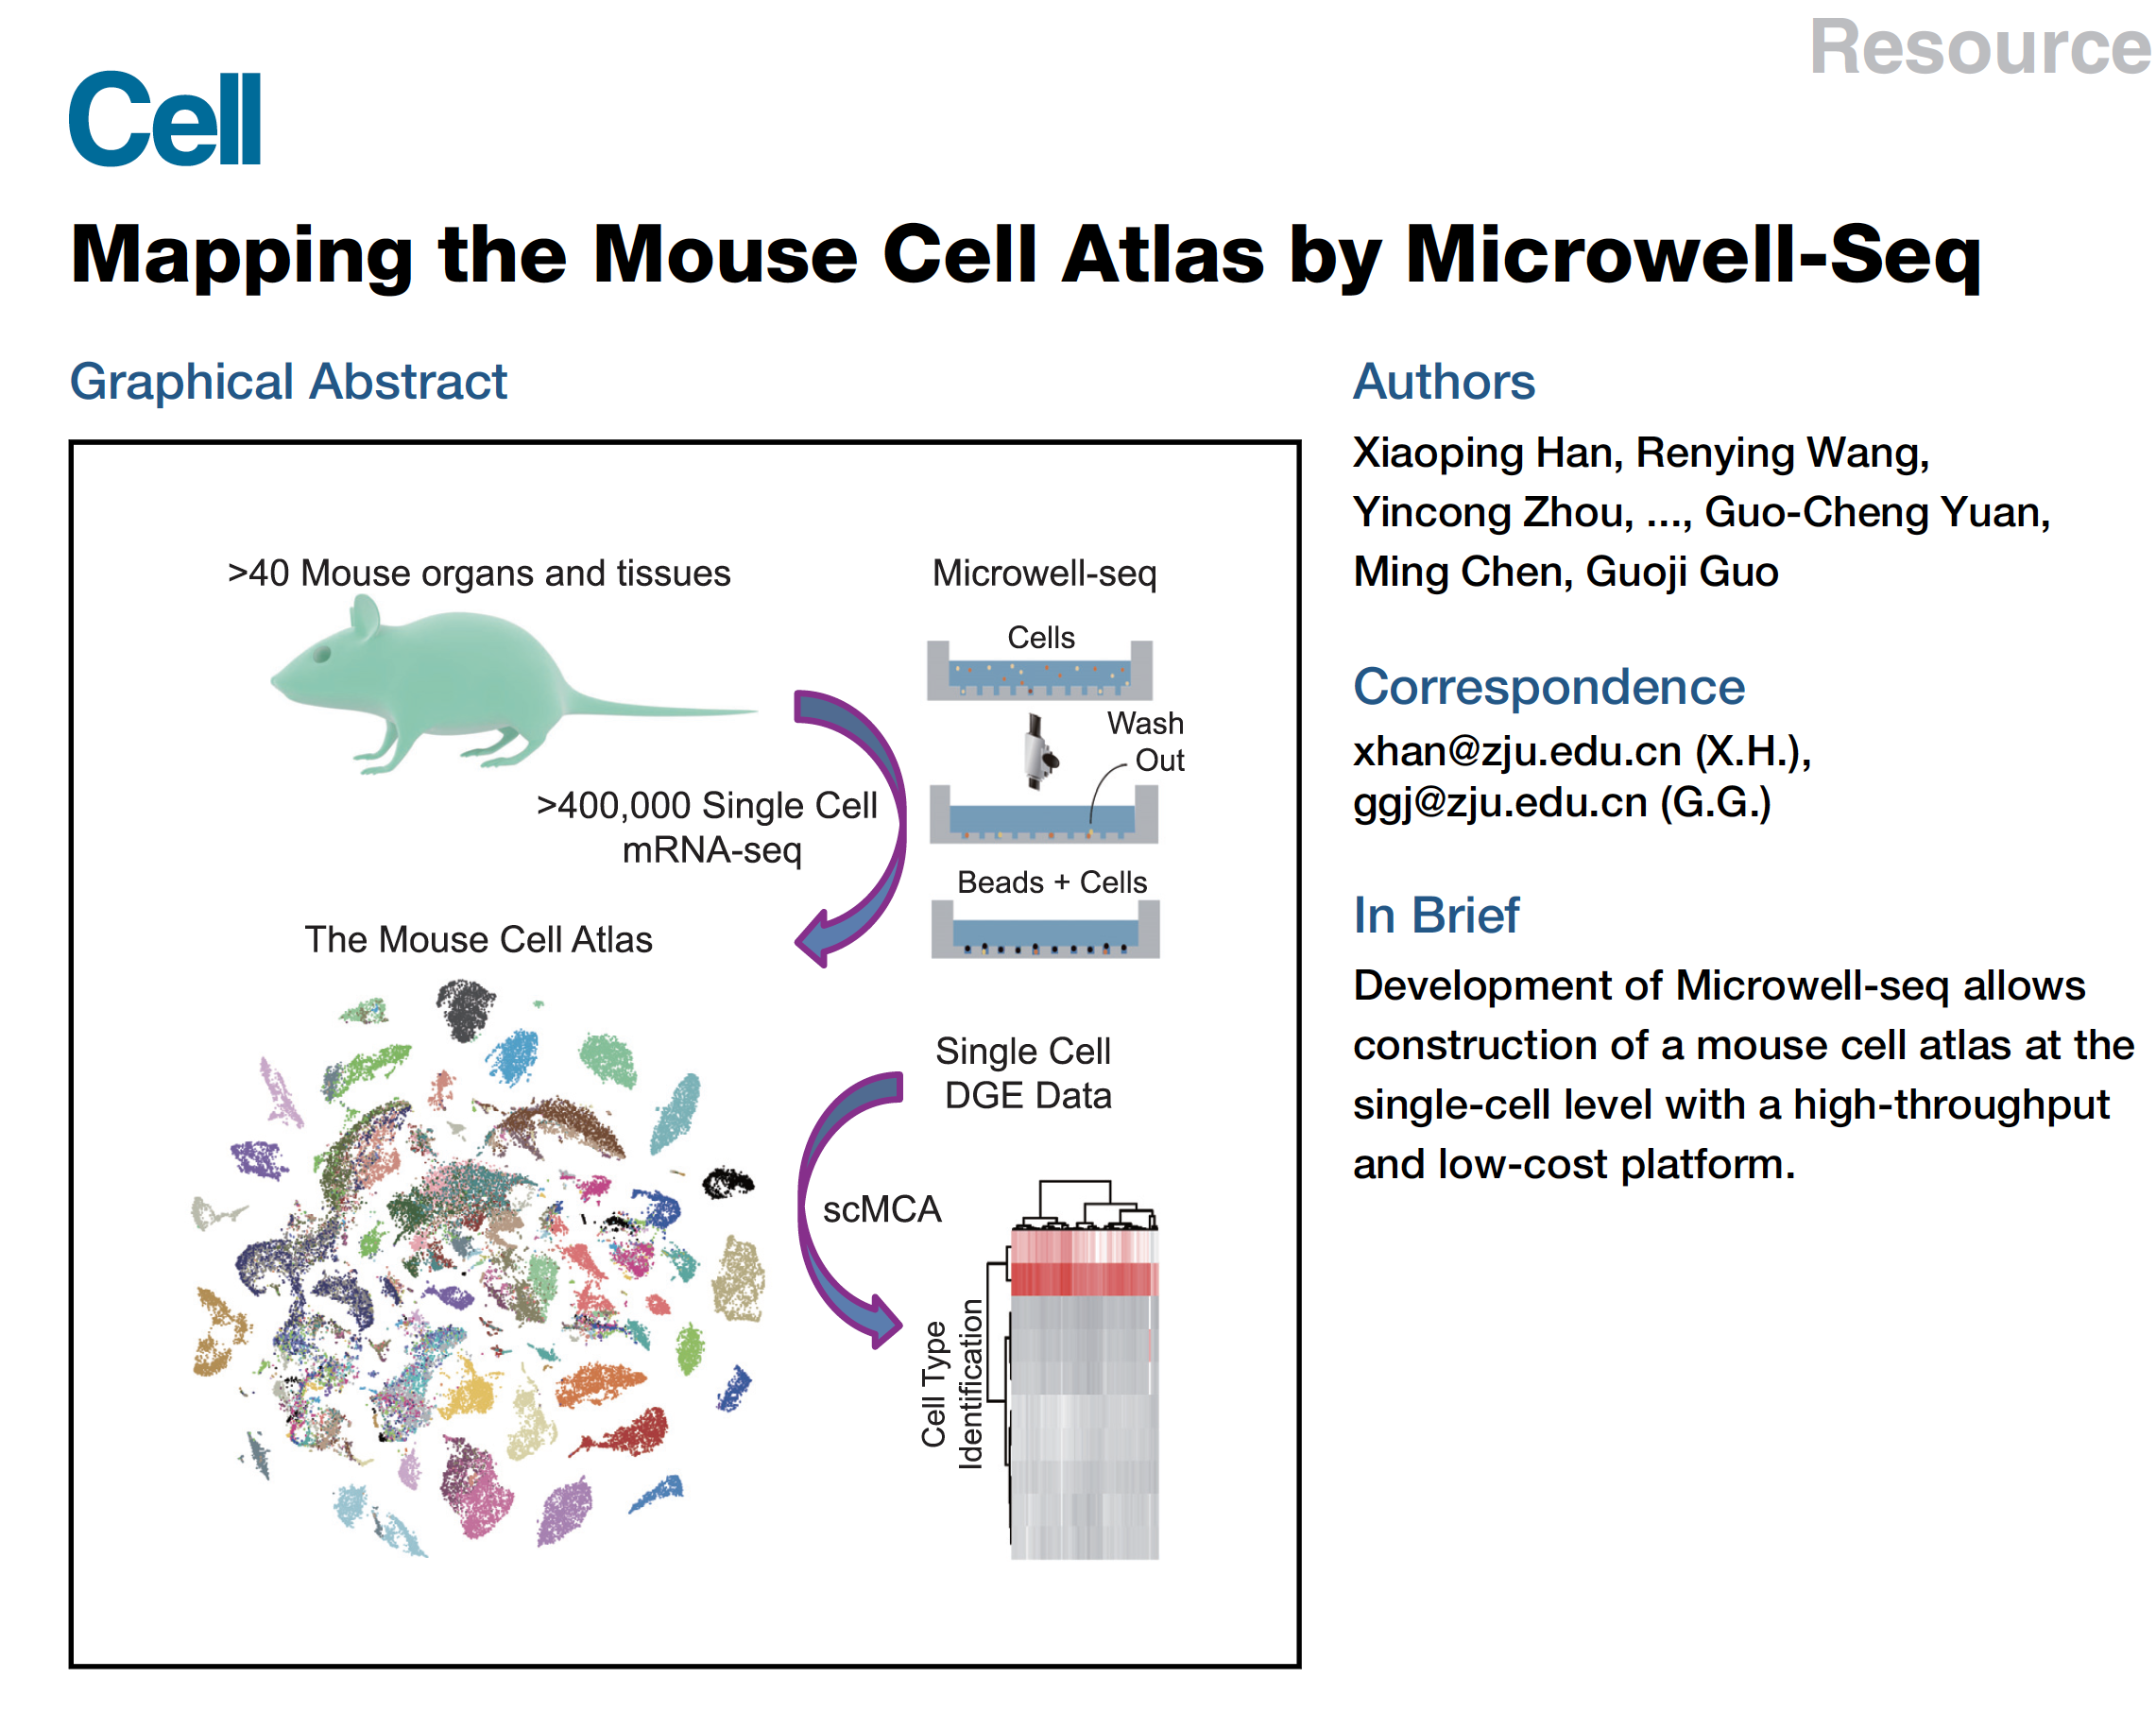
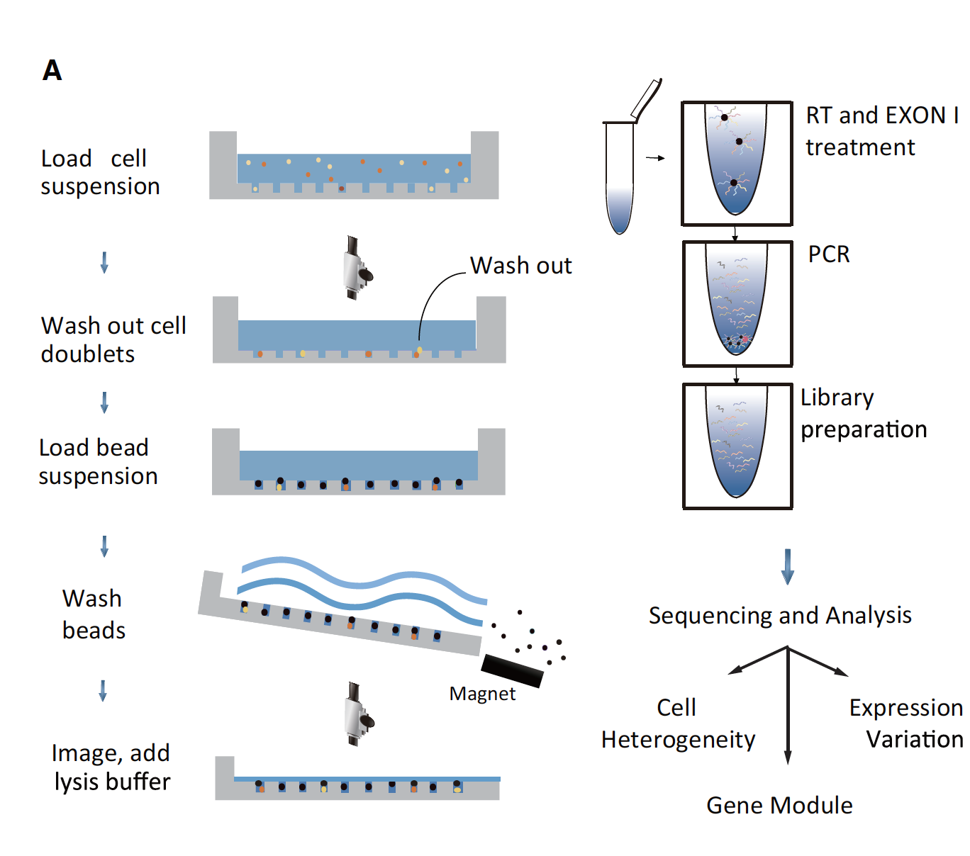
Project 3

Slide 9
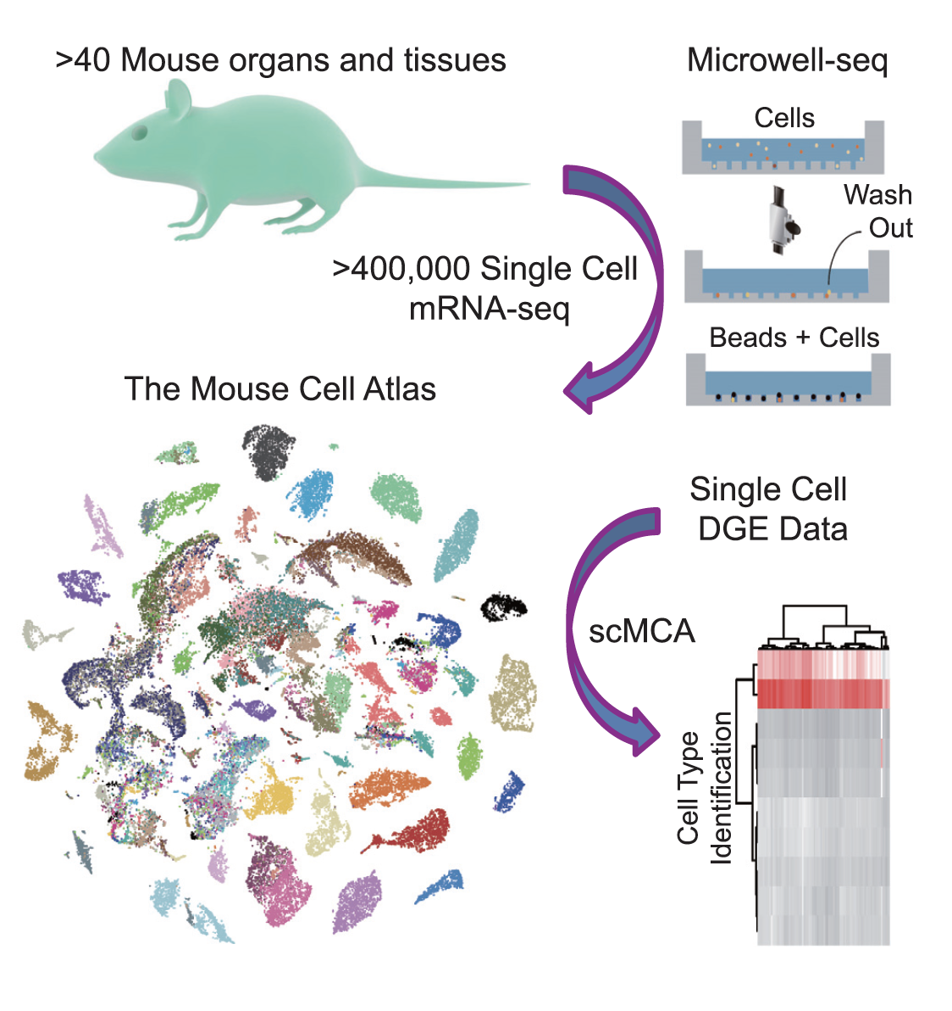
Project 3.
analyzed more than 400,000 single cells covering all of the major mouseorgans and constructed a basic scheme for a mouse cell atlas (MCA). We reveal a single-cell hierarchy for many tissues that have not been well characterized previously
What do you get:
4310 cells
6 tissues (5 immune and 1 epithelial)
18 Mouse
Questions to Answer.
What is the quality of the cells? Do you need to filter cells?
Is there any batch effect?
What are the main cell types present in the sample?
Can you detect Immune cells in multiple tissues?
Do you see any differences between the
same immune cell type between tissues?

Slide 10
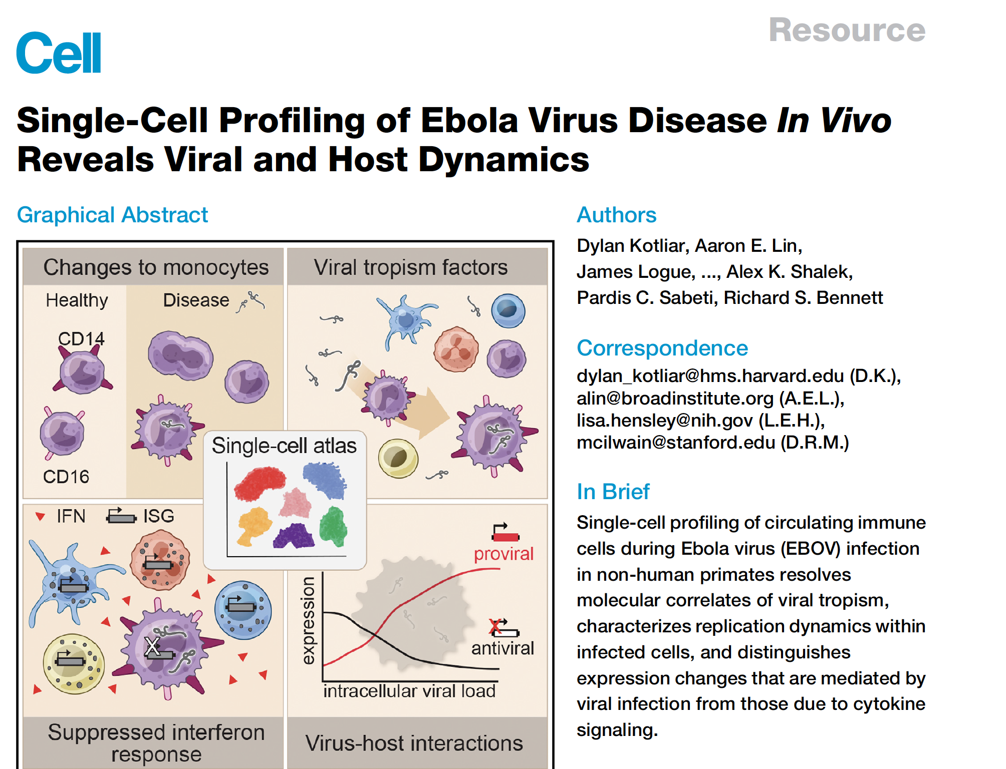
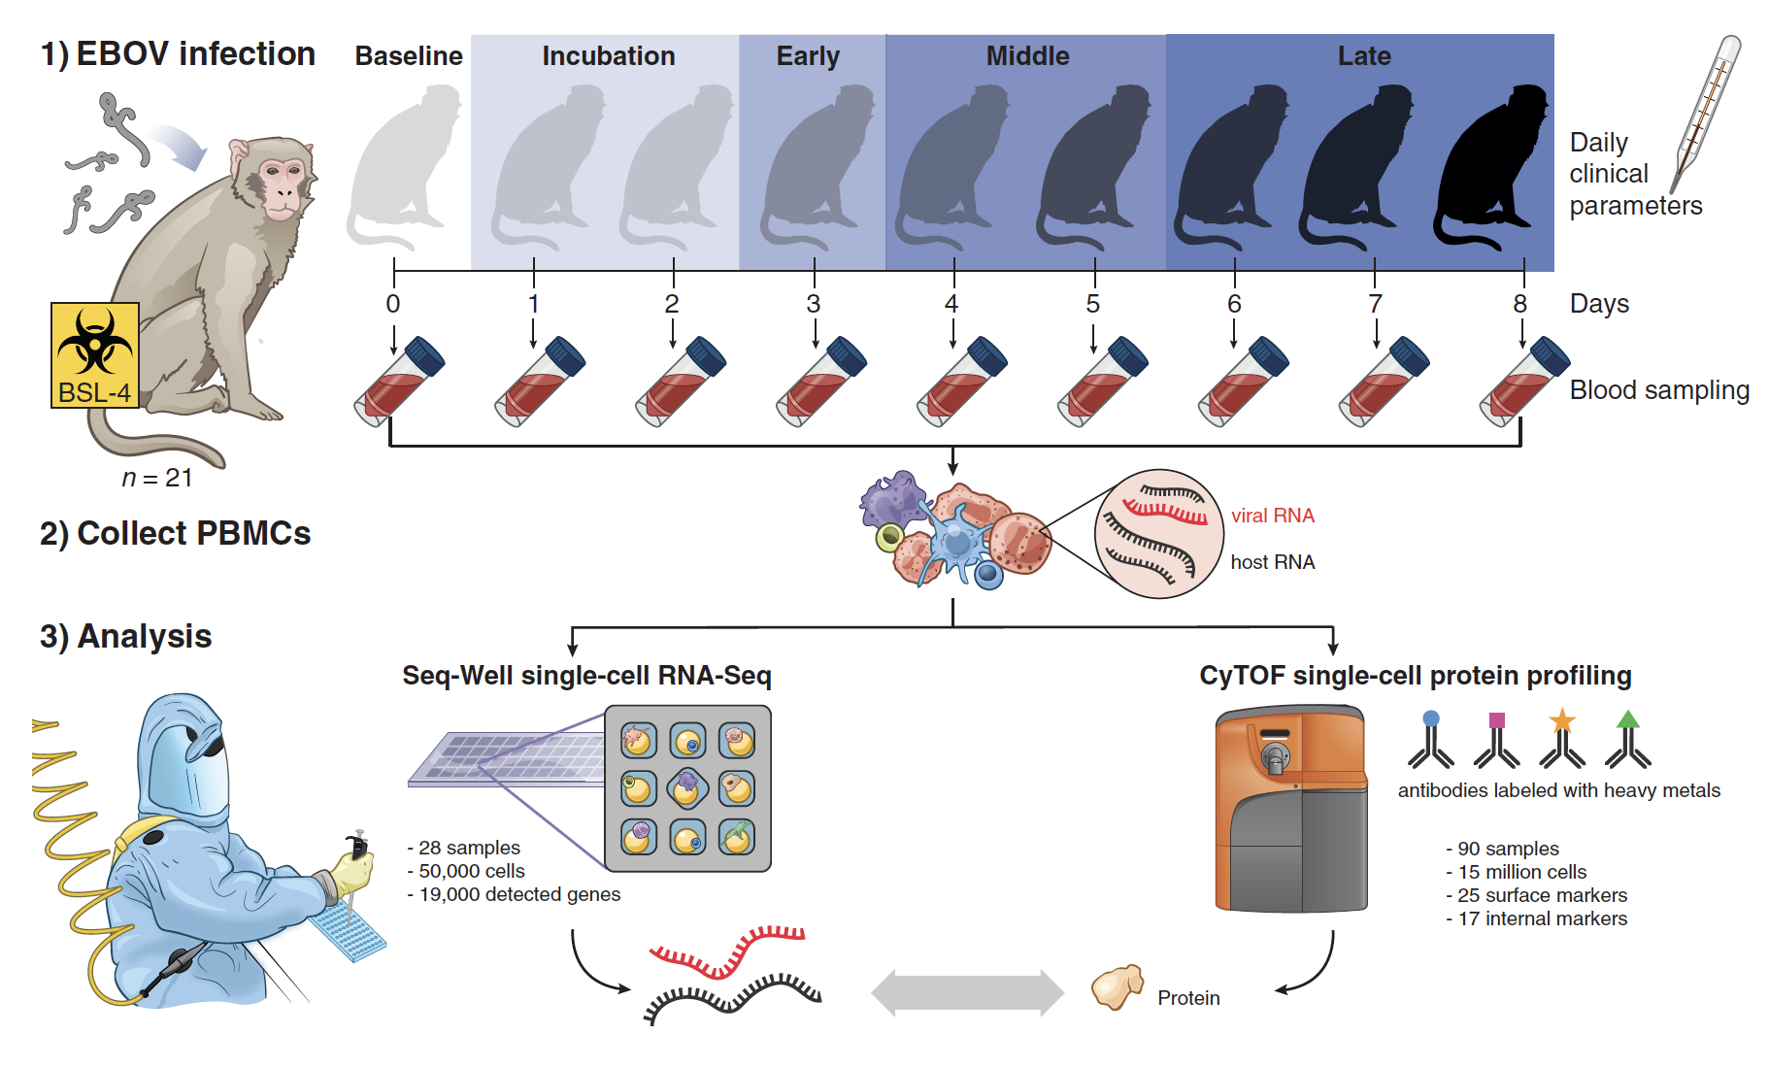
Project 4

Slide 11
Project 4.
Single-cell profiling of circulating immune cells during Ebola virus (EBOV) infection in non-human primates resolves molecular correlates of viral tropism, characterizes replication dynamics within infected cells, and distinguishes expression changes that are mediated by viral infection from those due to cytokine signaling.
What do you get:
3607 cells
13 Monkeys
5 Timepoints (DPI)
Questions to Answer.
What is the quality of the cells? Do you need to filter cells?
Is there any batch effect between monkeys?
What are the main cell types present in the sample?
Where can we detect ebola transcripts?
Do you see any differences between timepoints?
Notes:
Single-cell profiling of circulating immunecells during Ebola virus (EBOV) infection in non-human primates resolves molecular correlates of viral tropism, characterizes replication dynamics within infected cells, and distinguishes expression changes that are mediated by viral infection from those due to cytokine signaling.

Slide 12
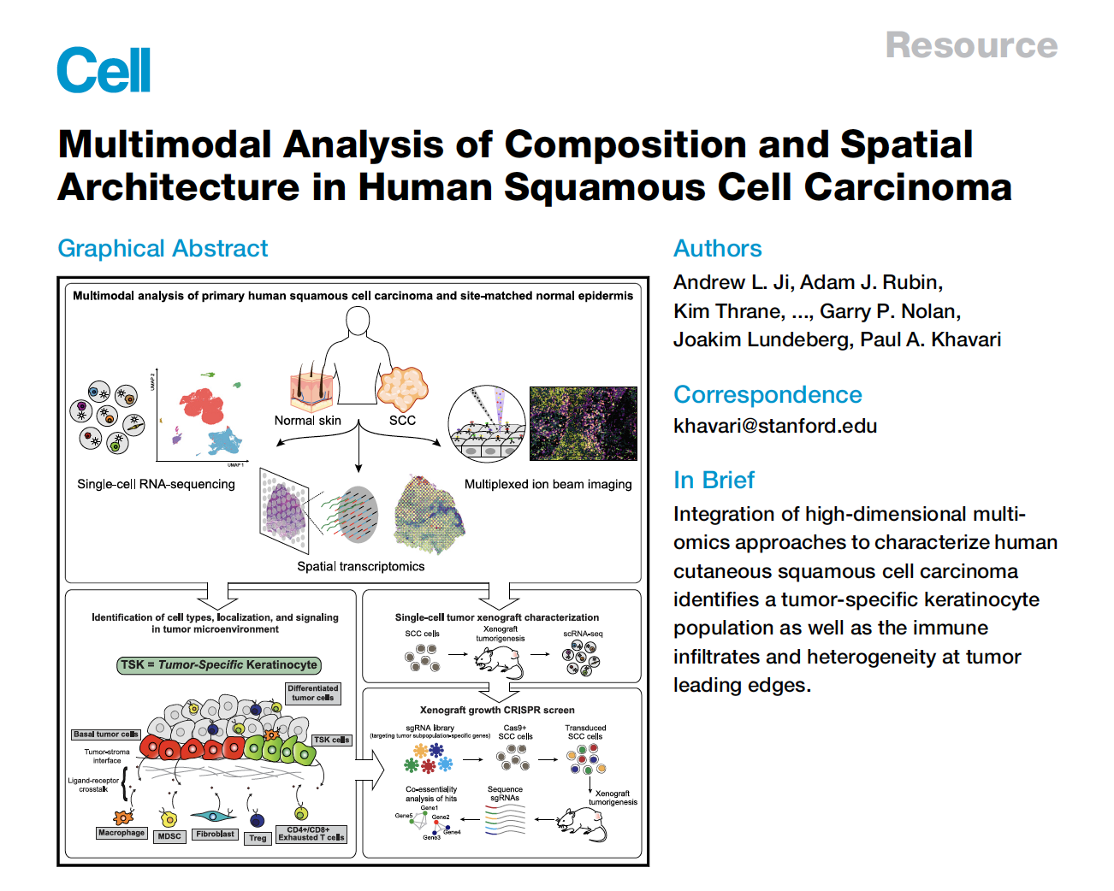
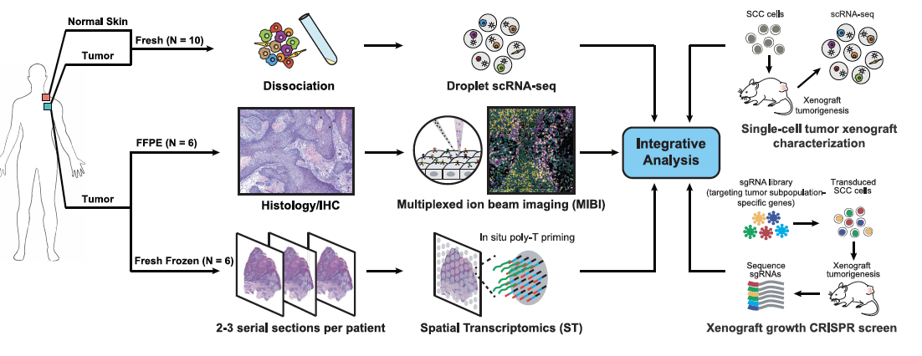
Project 5

Slide 13
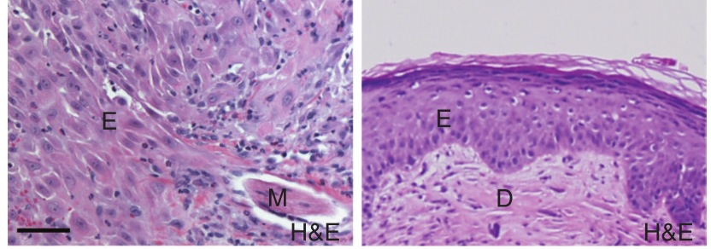
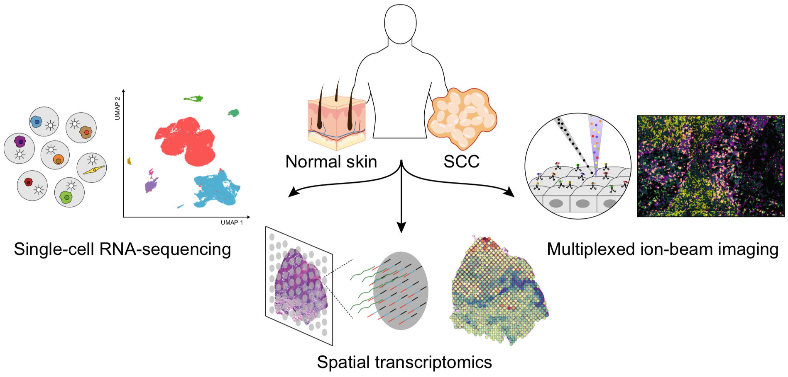
Project 5: comparison of T cells in healthy skin and skim tumors
To define the cellular composition and architecture of cutaneous squamous cell carcinoma (cSCC), we combined single-cell RNA sequencing with spatial transcriptomics and multiplexed ion beam imaging from a series of human cSCCs and matched normal skin. These data define cSCC tumor and stromal cell subpopulations, the spatial niches where they interact, and the communicating gene networks that they engage in cancer.
What do you get
1889 cells
11 donors
Tumor and normal samples
Normal skin
Cutaneous squamous cell carcinoma
Questions
Do T cells in normal tissue look different than T cells in tumors?
Are tumor T cells similar across patients?
What are the types of T cells that we observe in tumors?
Do we see many exhausted or proliferating cells?
Ji et al., 2020

